Slide 1
Introduction to the Command Line for Biologists
R. Burke Squires
Computational Genomics Specialist
BCBB / OCICB / NIAID / NIH

Slide 2
But…but...but...
Why do I have to learn about the command line?
What IS the command line?
I like my…
Mac OS
Windows OS
GUI (Graphical user interface)
...
Relax!

Slide 3
Objectives
Explain one or more advantages to using the command line for research
Explain one or more advantages to using the command line for programming
Be able to get to the command line on your computer
Understand how to navigate a linux operating system
Know one or more command to examine and manipulate large files (1 gigbit+)
Notes:
combine with outline?
Say not expert of Linux (and remind throughout) that I’m giving them references
It’s hard to learn a new OS, so don’t be discouraged. It’s lots of information. Give the most important.
Manage expectations of the class and get through the Linux stuff quickly so I can get to the LOCUS stuff.

Slide 4
Outline
Motivation
A brief history of Linux
Defining some terms
Command line
Getting in, getting out
Just enough…
Navigation
Working with Files
Grep
Pipelining
Where you can learn more

Slide 5
Motivation

Slide 6
Motivation: Why Learn to Use the Command Line
Enable you to write successful python programs
Programs that require you to know where your data file IS, and where you want your output to GO!

Slide 7
Motivation: Why Learn to Use the Command Line
Enable you to run the many common bioinformatics software programs
Open source bioinformatics software are available for Linux and can be run on a laptop, desktop, or computing cluster (aka super computer)

Slide 8
Motivation: Why Learn to Use the Command Line
Enable you to perform analyses on computer clusters
Analyze data that is too large to analyze on a laptop or desktop

Slide 9
Motivation: Why Learn to Use the Command Line
Enable you to use (some of the many) linux programs to do one thing very well and fast
Working with text files is especially fast and easy, even for very large files

Slide 10
Motivation: Why Learn to Use the Command Line
Enable you to compete with most biologists who know how to use the command line and give you a competitive advantage over those who do not

Slide 11
Motivation: Why Learn to Use the Command Line
Use the best tool for the job…

Slide 12
Motivation: Why Learn to Use the Command Line
Enable you to take one step closer to becoming a reproducible scientist
How might embracing the command line (and python programming) enable your research to be more reproducible?

Slide 13
A Brief History of Linux

Slide 14
What is Linux?
Version 1:
An free and open source operating system (OS) that interacts with, and controls, computer hardware; similar to macOS, Windows

Slide 15
What is Linux?
I wonder what a “kernel” is?
Version 2:
A free and open source operating system (OS), built using the linux kernel, that interacts with, and controls, computer hardware; similar to macOS, Windows

Slide 16
What is Linux?
I have a family?
Version 3:
“A family of free and open-source software operating system distributions built around the Linux kernel”

Slide 17
What is Linux?
What is the rest of that stuff?
Programs written by GNU project programmers
Shell, etc
GNU/Linux
“GNU” = “GNU is Not Unix”
Linux = GNU/Linux = UNIX (=> POSIX)
I’m GNU here!
http://uw714doc.sco.com/en/SHL_using/_The_design_of_the_u1_Operating_System.html

Slide 18
Why Recreate UNIX?
UNIX
Linux (kernel)
Developed at AT&T Bell Labs in 1969
Commercial
Capabilities / Philosophy:
Scalability
Modularity
Portability
Developed by Linus Torvalds in 1991
Open Source
Capabilities / Philosophy:
Scalability
Modularity
Portability
Free

Slide 19
Introduction: UNIX vs. Linux vs. macOS vs Windows
 | UNIX | Linux | macOS | Windows <10 | Windows 10
Started | 1969 | 1991 | 1987 | 1993 (1981) | 1993 (1981)
Source code | Closed | Open | Mixed | Closed | Closed
Kernel | UNIX | Linux | Linux | Windows | Windows
Interface | CLI (GUI) | CLI, GUI | GUI (CLI) | GUI (DOS) | GUI (CLI, DOS)
64 bit | Yes | Yes | Yes | Yes | Yes
Runs Linux commands | Yes | Yes | Yes | No | Yes (ubuntu on windows)
Protected memory | Yes (1969) | Yes (1991) | Yes (1987) | Yes (1993) | Yes (1993)
MS Office | No | No | Yes | Yes | Yes
For more info: https://en.wikipedia.org/wiki/Comparison_of_operating_systems

Slide 20
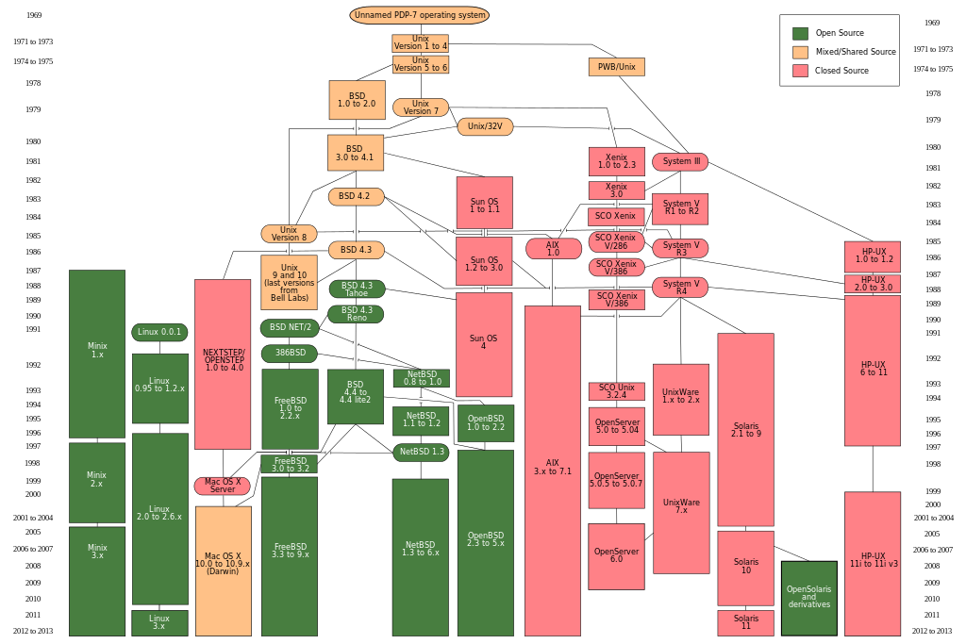
Introduction: Linux / macOS Timeline
1969
.
.
.
.
.
.
.
.
.
.
.
.
.
.
2013

Slide 21
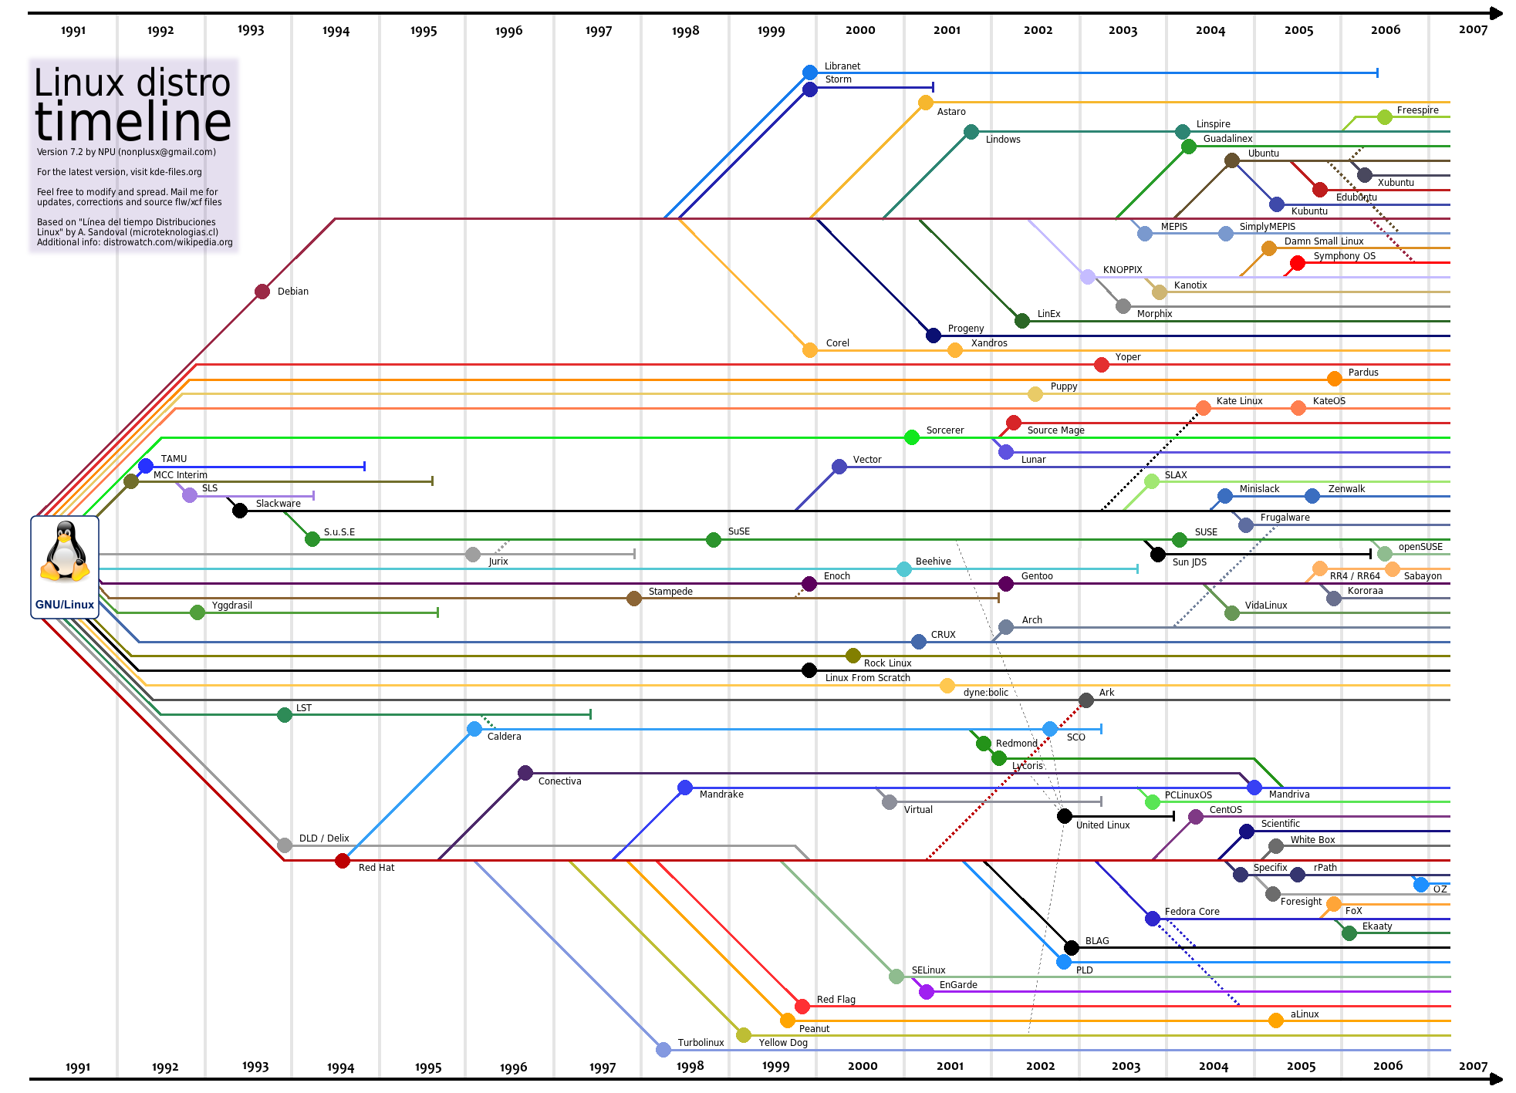
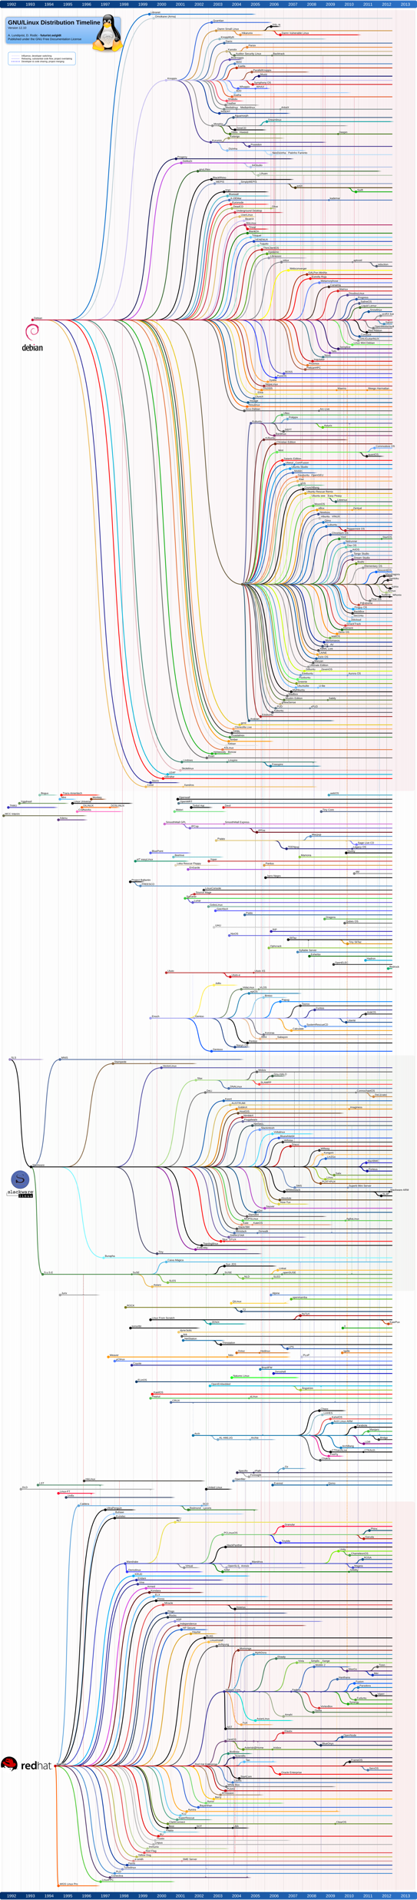
Introduction: Linux Distributions
Notes:
https://linuxhere.files.wordpress.com/2010/08/lintimeline2.png
http://futurist.se/gldt/wp-content/uploads/12.10/gldt1210.png

Slide 22
Interacting with Linux
(How do you get to the command line?)
Notes:
Although we’ve tried to give you as much control with the interface as you have with the command line, there are still a few limitations—the main one being for those that don’t have any interface at all. So in many cases, we still need to learn to use the command line. I’ll try to walk you through some of the basic commands that are going to be helpful for you so that you feel comfortable in a terminal window. Feel free to try some of them as we go along.

Slide 23
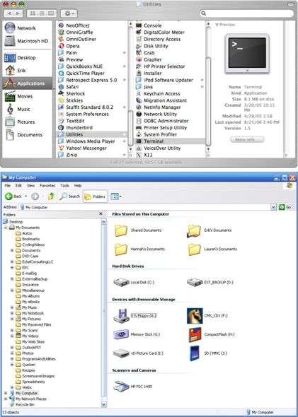
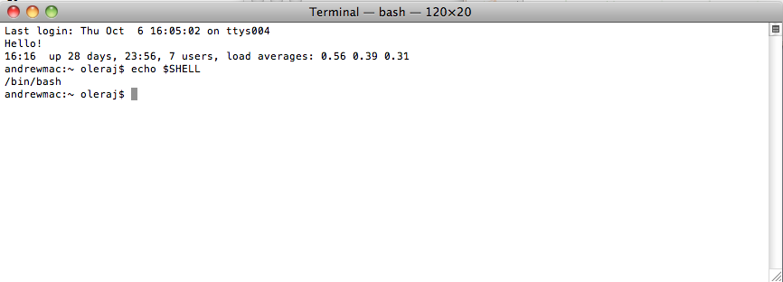
Interacting with Linux: File Manager / Browser by Operating System
OS: Windows macOS Linux
File
Manager: Windows Explorer Finder Shell
Notes:
http://www.techrepublic.com/photos/mac-os-x-and-windows-xp-compared/33614?seq=6&tag=siu-container;photopaging#photopaging

Slide 24
Interacting with Linux: Accessing the Shell
Terminal (then)
Terminal emulator (now)
“Terminal” (macOS; a particular terminal emulator)

Slide 25
Interacting with Linux: Accessing the Shell (with a Terminal Emulator)
Mac / Linux
Windows
A Terminal emulator is already installed!
Mac:
Open the Terminal
Applications => Utilities => Terminal
Linux
Open the Terminal
You need to install a version of linux
Windows 7, 8
Install git bash for windows
https://git-for-windows.github.io
Windows 10
Install Ubuntu through the Windows Store
https://www.microsoft.com/en-us/store/p/ubuntu/9nblggh4msv6

Slide 26
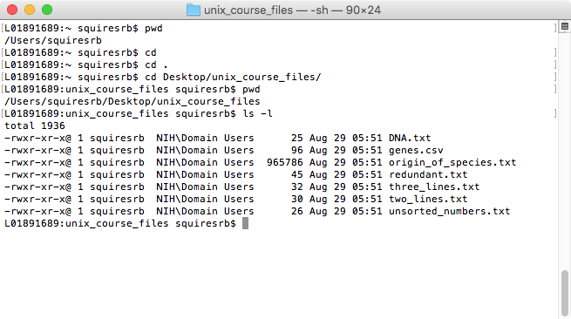
Interacting with Linux: Anatomy of the Terminal, “Command Line”, or “Shell”
Command
Argument
Window
Command line
Output
Cursor
Prompt (computer_name:current_directory username)
Notes:
already opened, but on mac Applications -> Utilities -> Terminal
Windows: install a terminal, e.g., putty or Secure shell

Slide 27
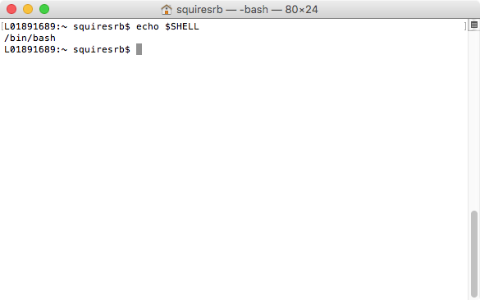
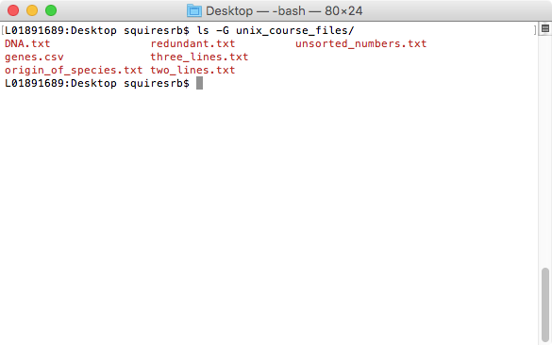
How to execute a command
command
argument
output
command
argument
option
output
Notes:
----- Meeting Notes (10/11/11 13:40) -----
zoom in on terminal for the command

Slide 28
Help!
Whenever you need help with a command type “man” and the command name

Slide 29
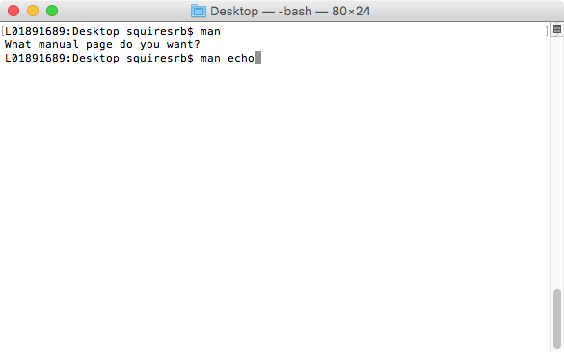
Help!

Slide 30
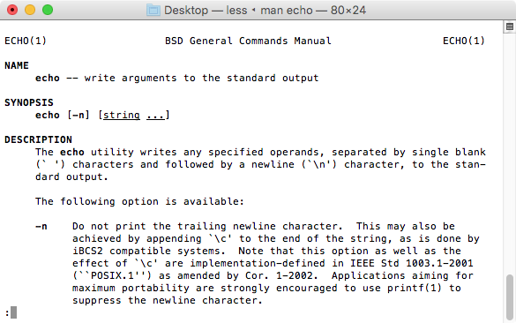
Help!

Slide 31
What is the “shell”?
After logging in, Linux starts another program called the shell
The shell interprets commands the user types and manages their execution
The shell communicates with the internal part of the operating system called the kernel
The most popular shells are: tcsh, csh, korn, and bash
The differences are most times subtle
For this tutorial, we are using bash
Shell commands are CASE SENSITIVE!

Slide 32
Tips To Make Life Easier!
Speed
Movement
Tab completion: hit Tab to make computer guess your filename.
type: ls unix[Tab]
result: ls unix_course_files
If nothing happens on the first tab, press tab again…
Aliases (put in ~/.bashrc file)
alias ls='ls -AFG'
alias ll='ls -lrhT'
Up Arrow
Recalls previous command(s)
history
show every command issued during the session
!ls
repeat the previous “ls” command
!!
repeat the previous command
Ctrl+a
go to beginning of line
Ctrl+e
go to end of line
Ctrl+c
kill current running process in terminal

Slide 33
Navigating with the Shell

Slide 34
Navigation: Typical Linux Directory Structure
pwd “print working directory”; tells where you are
/
“root”
/bin
essential binaries
/etc
system config
/usr
shared, read-only
/var
variable data
/sbin
system binaries
/home
user directories
/mnt
network drives
/usr/bin
other binaries
/usr/local
installed packages
/usr/local/bin
installed binaries
/var/tmp
program caches
/home/USER1
USER1 home
/home/USER2
USER2 home
Notes:
You’re in a directory. What directory? pwd
----- Meeting Notes (10/11/11 13:40) -----
highlight a few only

Slide 35
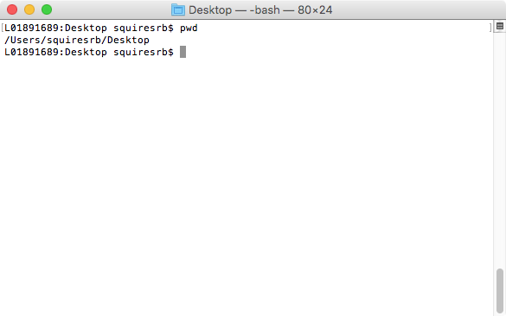
Command: pwd
To find your “print working directory” use “pwd”
Note: we are “printing” the information to the screen ☺

Slide 36
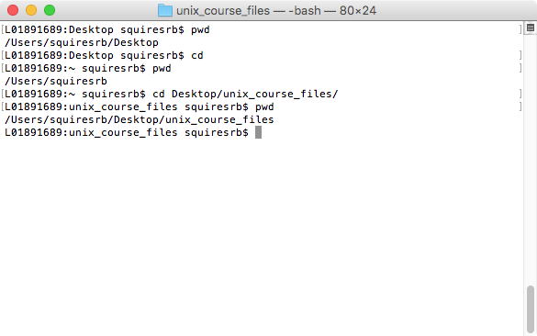
Command: cd
To “change directory” type:
“cd”
To go to home directory:
“cd ~”
“cd”
To go to parent directory:
“cd ..”
Note: “..” is a shortcut to the parent directory

Slide 37
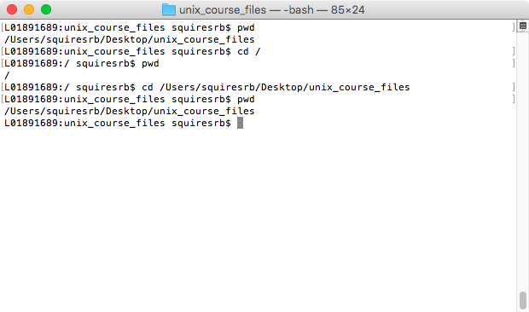
Paths: Relative vs Absolute
Relative paths:
“.” current directory
“..” parent directory
”./unix_course_files” directory “output” within current directory
To go to specific directory:
“cd /users/squiresrb/”
“cd /users/squiresrb/Desktop/unix_course_files/”

Slide 38
Navigation in Summary
pwd
print working directory
cd
change directory

Slide 39
Working with Directories

Slide 40
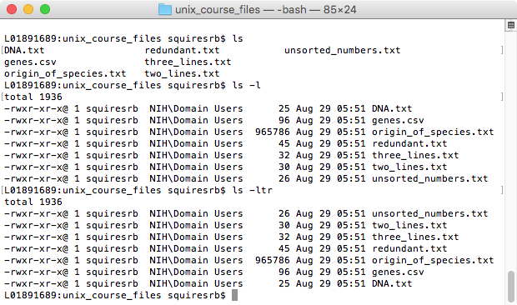
Command: ls
To “list” the files in the current directory use
“ls”
ls has many options
-l long list (displays lots of info)
-t sort by modification time
-S sort by size
-h list file sizes in human readable format
-r reverse the order
“man ls” for more options
Options can be combined: “ls -ltr”

Slide 41
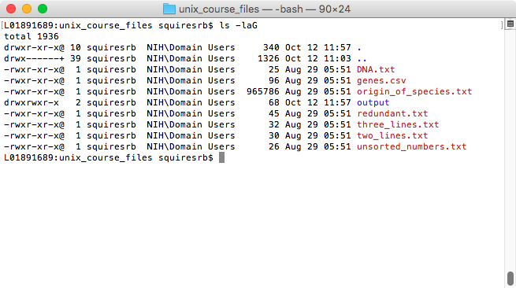
Listed Columns
File type (d[irectory], - [file], l[ink]) and the permission given on the file
Number of memory blocks taken by the file or directory.
Owner of the file. This is the Unix user who created this file.
Group of the owner. Every Unix user will have an associated group.
File size in bytes.
Date and the time when this file was created or modified for the last time.
File or the directory name.

Slide 42
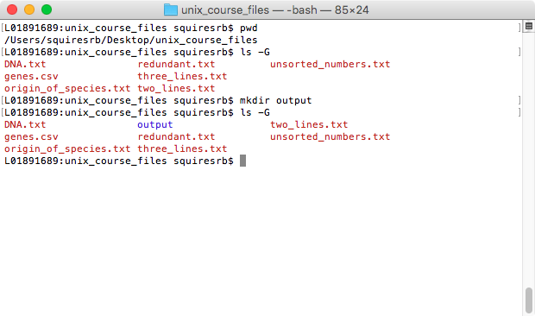
Command: mkdir
To create a new directory or ”make directory” use “mkdir”
(Notice we use the –G option to “ls” to show directories in a different color (blue))

Slide 43
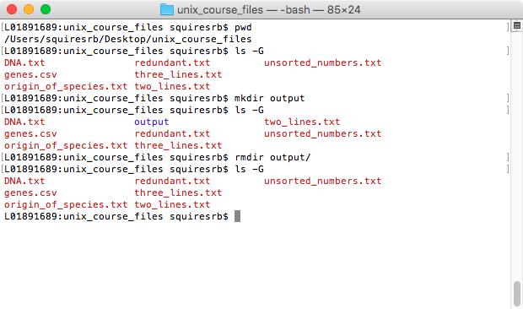
Command: rmdir
To “remove directory” and empty directory use “rmdir”

Slide 44
Working with Files

Slide 45
Command: ls
We already saw how we can list or “ls” the files in a directory.

Slide 46
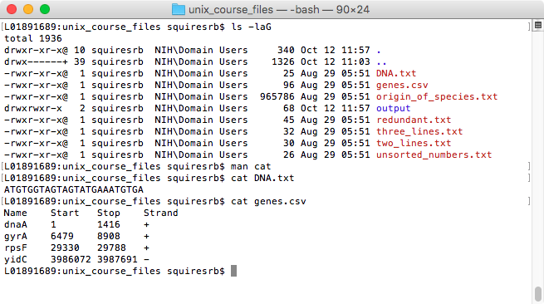
Command: cat
To view or “concatenate and print” data use cat.
Dumps an entire file to standard output
Good for displaying short, simple files

Slide 47
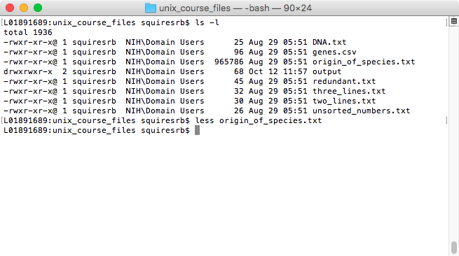
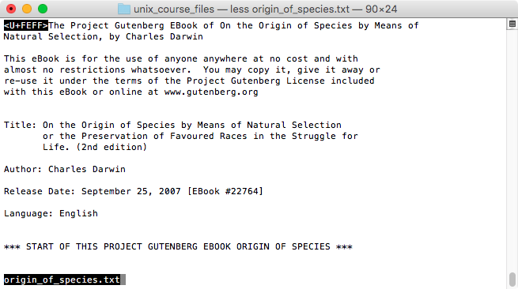
Command: less
Shows “less” then the entire file that “cat” does, allowing forward / backward movement within it
“return” scrolls forward one line at a time
“space” advances one page at a time
“y” scrolls back one line, b one page
use “/” to search for a string
Press “q” to quit

Slide 48
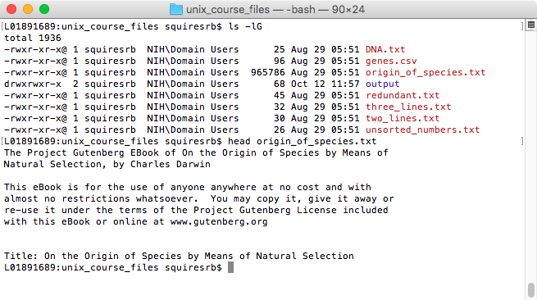
Command: head
“head” displays the top part of a file
By default it shows the first 10 lines
“n” option allows you to change the number of lines; “head –n 50 file.txt” displays the first 50 lines of file.txt

Slide 49
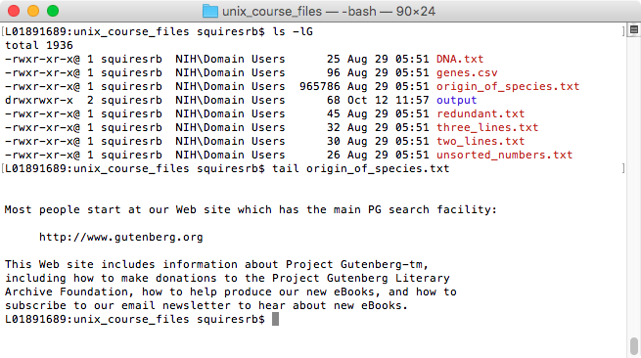
Command: tail
“tail” displays the top part of a file
By default it shows the last 10 lines
“n” option allows you to change the number of lines; “tail –n 50 file.txt” displays the last 50 lines of file.txt

Slide 50
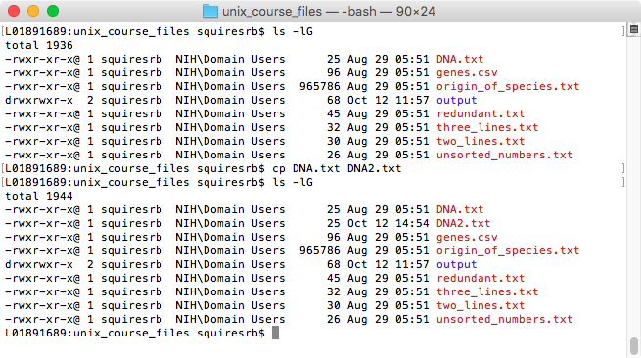
Command: cp
To copy a file use “cp”

Slide 51
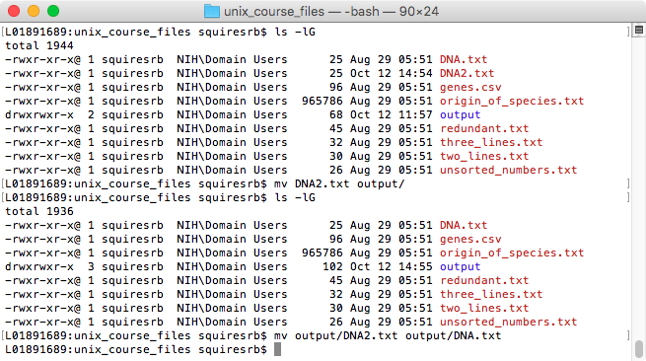
Command: mv
To move a file use “mv”
“mv” can also be used to rename a file:
mv DNA2.txt DNA3.txt

Slide 52
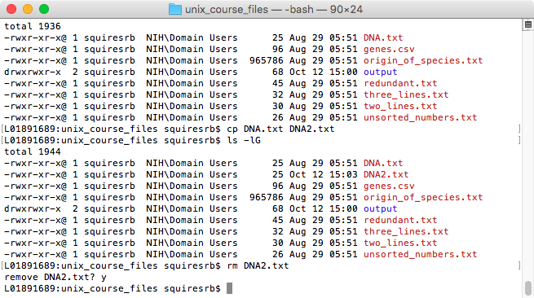
Command: rm
To remove a file use “rm”
To remove a file “recursively”: rm –r
Used to remove all files and directories
Be very careful, deletions are permanent in Linux

Slide 53
Working with Files: Creating Files in Linux
Requires the use of an Editor
Various Editors:
nano / pico
vi
emacs
Do not use:
Microsoft Word
WordPad
TextEdit (unless you set to plaintext)

Slide 54
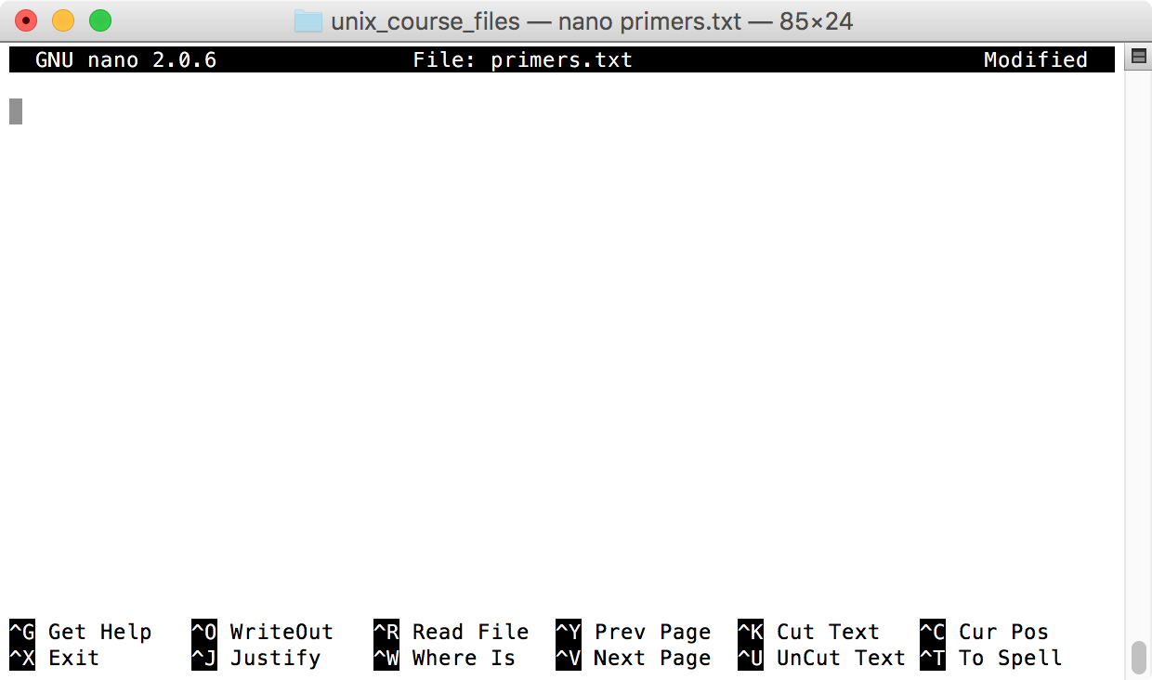
Editing A File Using pico or nano
Type “pico” or “nano” at the prompt
Caret or up arrow is the control key
Control X to exit. Remember to save

Slide 55
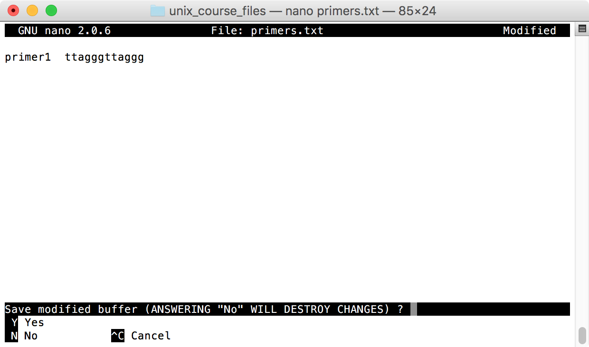
Editing A File Using nano
To save use “ctrl-x”

Slide 56
File Permissions
Each file in Linux has an associated permission level
This allows the user to prevent others from reading/writing/executing their files or directories
Use “ls -l filename” to find the permission level of that file

Slide 57
Permission levels
“r” means “read only” permission
“w” means “write” permission
“x” means “execute” permission
In case of directory, “x” grants permission to list directory contents

Slide 58
File Permissions
L01891689:unix_course_files squiresrb$ ls -lG
total 1944
-rwxr-xr-x@ 1 squiresrb NIH\Domain Users 25 Aug 29 05:51 DNA.txt
-rwxr-xr-x@ 1 squiresrb NIH\Domain Users 25 Oct 12 15:03 DNA2.tx
-rwxr-xr-x@ 1 squiresrb NIH\Domain Users 96 Aug 29 05:51 genes.c
-rwxr-xr-x@ 1 squiresrb NIH\Domain Users 965786 Aug 29 05:51 origin_
drwxrwxr-x 2 squiresrb NIH\Domain Users 68 Oct 12 15:00 output
-rwxr-xr-x@ 1 squiresrb NIH\Domain Users 45 Aug 29 05:51 redunda
-rwxr-xr-x@ 1 squiresrb NIH\Domain Users 32 Aug 29 05:51 three_l
-rwxr-xr-x@ 1 squiresrb NIH\Domain Users 30 Aug 29 05:51 two_lin
-rwxr-xr-x@ 1 squiresrb NIH\Domain Users 26 Aug 29 05:51 unsorte
User (you)
Group
Everyone

Slide 59
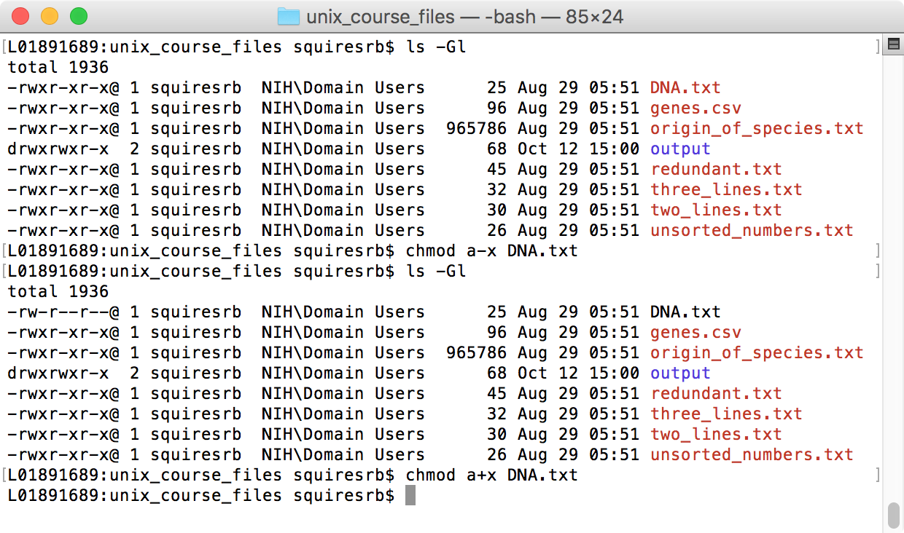
Command: chmod
“change mode”
If you own the file, you can change it’s permissions with “chmod”
Syntax: chmod [user/group/others/all]+[permission] [file(s)]
To grant execute permission to all type:
chmod a+x DNA.txt

Slide 60
Useful Unix Programs

Slide 61
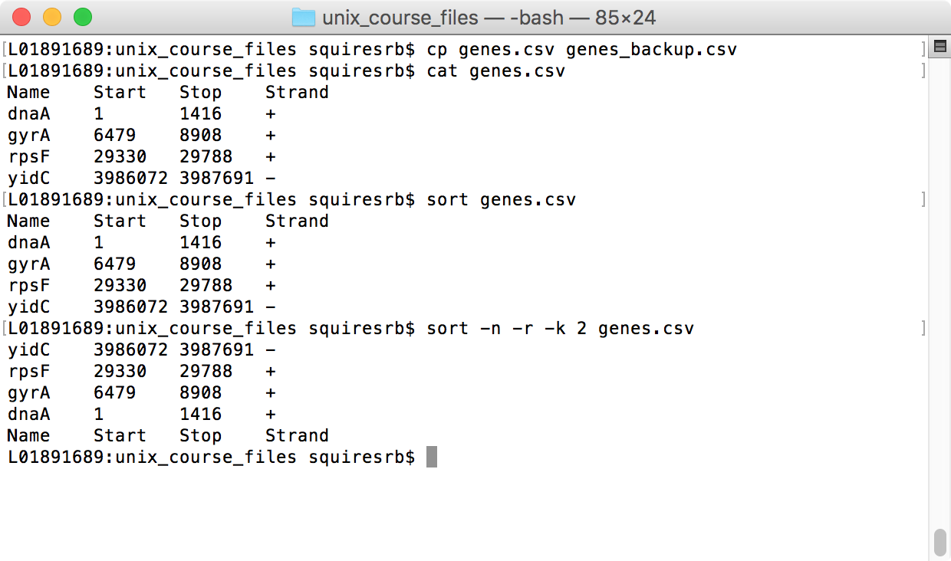
Commands: sort
sort genes.csv
alphabetize “genes.csv”
sort -n genes.csv
sort “file1” by number
sort -n -r -k 2 genes.csv
sort “file1” by the second word or column in reverse numerical order
Notes:
remove first partcat > file1 write “file1”, containing “mouse cat dog”
mouse cat dog
Ctrl-d
cat >> file1 append “man woman child” onto “file1”
man woman child
Ctrl-d

Slide 62
Command: diff
To compare to files for differences use “diff”
Try: diff /dev/null hello.txt
/dev/null is a special address -- it is always empty, and anything moved there is deleted

Slide 63
Basic Linux Commands: grep (search within files)
g/re/p (globally search a regular expression and print)
grep key file* report the file name and line where “key” appears in file*
grep -v key file* report the file names of files that do not match “key”
man grep see other functions of grep. (lots! regular expressions!)
Notes:
remove cut, uniq, awk sed (keep man pages)
cut -c 2 file1 report the second character in each line of file1
cut -c 2,4 file1 report the second and fourth character in each line of file1
cut -c 2-4 file1 report the second to fourth characters in each line of file1
cut -d ' ' -f 2 file1 report the second word in each line of file1 (Tab is default column delimiter)
uniq file1 list a line if it is different than the previous one (useful after “sort”)
awk and sed powerful command-line manipulation of file contents;
grep -h key file* report only the line where “key” appears in file*
grep -l key file* report only the file names where “key” appears in file*
grep -E "key1|key2" file* report the file name and line where either “key1” or “key2” appear in file*; allows other regular expressions

Slide 64
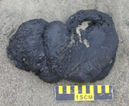
Basic Linux Commands: File Compression
gzip temp/* compress every file in “temp”; adds .gz extension
gunzip temp/*.gz expand every “gzipped” file in “temp”
tar -zcvf myfiles.tar.gz temp/* create a single archive of every file in “temp”
tar –xvf test_data.tar.gz copy every file out of the archive
“tarball” ≠
Notes:
prints to the screen
tar with zip…?

Slide 65
Basic Linux Commands: Pipelining
ls | wc count the number of files in a directory
grep | sort > file1 pull out searched-for lines, sort them, and write a new file
Exercise 2:
head –n 2000 lymph1k.fastq | gzip > head2K.txt.gz
Notes:
grep | cut | sort | uniq -c | sort -n –r
Pareto-like histogram
ls -lrhT | more page through a detailed, long list of files

Slide 66
Input/Output Redirection (“piping”)
Programs can output to other programs
Called “piping”
“program_a | program_b”
program_a’s output becomes program_b’s input
“program_a > file.txt”
program_a’s output is written to a file called “file.txt”
“program_a < input.txt”
program_a gets its input from a file called “input.txt”

Slide 67
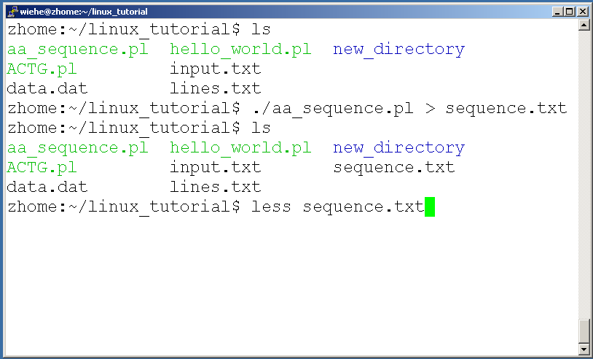
Examples Of Piping

Slide 68
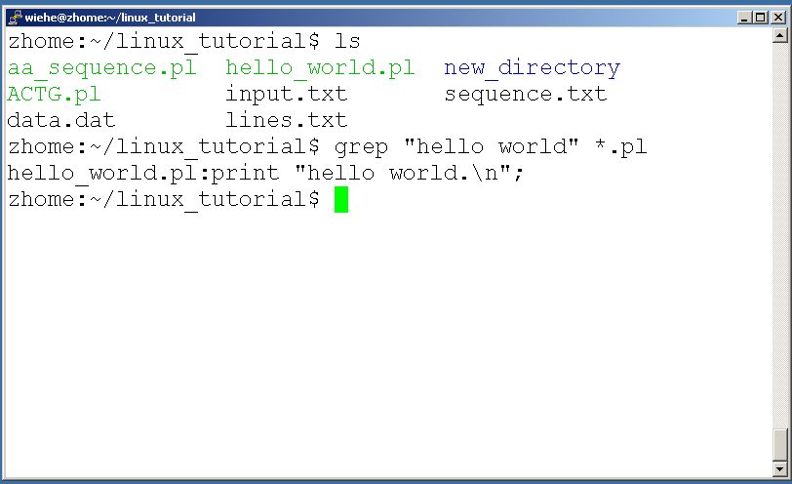
Command: grep
Search files in a directory for a specific string use “grep”

Slide 69
Running A Program (a.k.a. a job)
Make sure the program has executable permissions
Use “./” to run the program

Slide 70
Commands: ssh (”secure shell”), scp (“secure copy”)
ssh is used to securely log in to remote systems, successor to telnet
ssh [username]@[hostname]
Try:
ssh yourusername@localhost
Type “exit” to log out of session
Scp is used to copy files to/from remote systems, syntax is similar to cp:
scp [local path] [usernme]@[hostname]:[remote file path]
Try:
scp hello.txt yourusername@localhost:scp-test.txt

Slide 71
Linux Web Resources
https://www.tutorialspoint.com/unix/
http://www.ee.surrey.ac.uk/Teaching/Linux/
http://www.ugu.com/sui/ugu/show?help.beginners
http://en.wikipedia.org/wiki/Linux

Slide 72




Recommended Reading
Linux in a Nutshell, Sixth Edition
Ellen Siever, Stephen Figgins, Robert Love, Arnold Robbins
Running Linux, 5th Edition
Matthias Kalle Dalheimer, Matt Welsh
Linux® Shells by Example,
Fourth Edition
Ellie Quigley

Slide 73
Recommended Reading
The Linux Command Line
By William Shotts
Download free from here.

Slide 74
Objectives
Explain one or more advantages to using the command line for research
Explain one or more advantages to using the command line for programming
Be able to get to the command line on your computer
Understand how to navigate a linux operating system
Know one or more command to examine and manipulate large files (1 gigbit+)
Notes:
combine with outline?
Say not expert of Linux (and remind throughout) that I’m giving them references
It’s hard to learn a new OS, so don’t be discouraged. It’s lots of information. Give the most important.
Manage expectations of the class and get through the Linux stuff quickly so I can get to the LOCUS stuff.

Slide 75
Questions?
Notes:
l’s 1’s slide…

